Slide 1




Price Comparison Website for Online Shopping
Coordinator:Mrs.M.Pragathi
Internal guide:Mrs.GSL.Poornima
BATCH: 14
22D21A05B2 Pyata Manaswini
22D21A0570 Chilkuri Manasa
23D25A0511 Kalva Rajini

Slide 2
CONTENTS
Abstract
1.Introduction
1.1 Purpose
1.2 Scope
2.Literature Survey
3.System Analysis
3.1 Existing System & Disadvantages
3.2 Problem Statement
3.3 Proposed System & Advantages
4.System Requirements Specification
4.1 Functional and Non Functional requirements
4.2 Software Requirements
4.3 Hardware Requirements
4.4 Technologies used
5.System Design
5.1 Architecture
5.2 System Modules
5.3 Data Flow Diagram
5.4 UML Diagrams

Slide 3
6. Implementation
6.1 Algorithms Used
6.2 Sample Code
7.System Testing
7.1 Test Cases
7.2 Results and Discussion
8.Conclusion and Future Scope
8.1 Conclusion
8.2 Future Scope
9.References

Slide 4
ABSTRACT
This project is about creating a Price Comparison Website for online shopping, where users can compare prices, product details, and availability from different online stores. The website helps shoppers find the best deals by displaying real-time prices and shipping costs across multiple retailers. The platform features an easy-to-use interface, allowing users to filter products by categories like price, brand, and ratings. It collects and updates product data continuously to ensure accuracy. This website aims to save users time and money while making online shopping more efficient.

Slide 5
1.INTRODUCTION
A price comparison website helps users find the best deals by comparing product prices across multiple e-commerce sites like Flipkart, eBay, and Amazon. It shows prices, shipping costs, and taxes from different retailers, often highlighting discounts and special offers. Once the consumer selects the best deal, they are redirected to the retailer’s site to complete the purchase.

Slide 6
1.1 Purpose
The purpose of a price comparison website is to help consumers find the best possible price for a product by comparing prices across multiple online retailers. These websites not only compare prices but also highlight discounts, special offers, and shipping costs ensuring shoppers get the most value for their money. Ultimately, the goal is to save time and money for consumers by making it easier to find the best prices online.

Slide 7
1.2 Scope
Price comparison websites help consumers find the best prices by showing prices from multiple online stores in one place. They make it easier to compare products like electronics, clothes, and home items, and often include user reviews or discounts. For stores, being listed on these sites helps attract more customers. In short, these websites make shopping easier, cheaper, and faster for everyone.

Slide 8
2.LITERATURE SURVEY
1. A Study on Price Comparison Websites Published in the Journal of E-Commerce Research (2020), this study explores the use of web scraping and API integration for collecting pricing data. The main limitation is that it depends on retailers providing open APIs, which restricts its scope. 2. Web Scraping for Dynamic Price Comparison This paper, presented at the Proceedings of the Web Data Conference in 2021, utilizes Python libraries such as Beautiful Soup and Scrapy for dynamic price extraction. However, it is prone to website blocking, making it less reliable for long-term usage

Slide 9
3. Blockchain in Price Comparison Platforms Published in the Blockchain Technology Journal (2022), this paper introduces a decentralized approach using smart contracts and blockchain for secure and transparent price comparisons. Its major drawback is the high cost of implementation. 4. AI-based Price Prediction Models Appearing in the International Journal of Consumer Behavior (2023), this paper leverages deep learning and regression analysis to predict price trends. While powerful, this method requires large datasets, which can be a challenge to obtain and manage.

Slide 10
5. Real-Time Price Monitoring in E-Commerce
Published in IEEE Access (2019), this study focuses on real-time price tracking using web scraping and API integration. Its effectiveness is hindered by potential website blocking and limitations posed by APIs.

Slide 11
3.SYSTEM ANALYSIS
3.1 Existing system:
The existing system of price comparison websites involves users searching for products they want to buy and then viewing prices from multiple online retailers. These websites gather information from various e-commerce platforms like Amazon, Flipkart, eBay, and others, showing the product's price, shipping fees, and sometimes available discounts. While these websites can be incredibly helpful, there are some disadvantages.

Slide 12
Disadvantages:
1.Data Accuracy and Integration: Ensuring the accuracy of prices and product availability across various online retailers was one of the challenges encountered. Maintaining real-time synchronization of data is complex and requires constant updates to the web scraping processes.
2.Legal and Ethical Concerns: Ensuring compliance with data collection practices and respecting privacy regulations required careful consideration. Partnerships with retailers had to be established to avoid scraping without permission.
3.Scalability Issues: Handling high volumes of traffic, especially during peak shopping seasons, posed challenges in terms of performance and system scaling

Slide 13
3.2 Problem statement
Current price comparison websites often provide incomplete or outdated information, focusing only on price and missing factors like shipping costs, delivery times, return policies, or customer service quality. Not all retailers are listed, and irrelevant ads or affiliate links can clutter the site, confusing shoppers. Additionally, lack of real-time updates can cause discrepancies, making the shopping experience less reliable.

Slide 14
3.3 Proposed System
The proposed system for a price comparison website aims to address the shortcomings of existing platforms by providing a more comprehensive, up-to-date, and user-friendly shopping experience. In this new system, the website will ensure real-time price updates, displaying accurate product prices, shipping costs, and availability. Additionally, it will offer detailed information about factors such as delivery times, return policies, and customer service ratings, enabling users to make more informed decisions beyond just price.

Slide 15
Advantages:
1.Accurate, Real-Time Data: The system will provide up-to-date product prices, availability, and shipping information, reducing the risk of outdated or incorrect details.
2.Comprehensive Comparison: Users will be able to compare products not just by price, but also by factors such as delivery time, return policy, customer reviews, and product features.
3.Improved User Experience: A clean and intuitive design will reduce clutter, making it easier for users to find the information they need without distractions from ads or irrelevant links.

Slide 16
4.Broader Retailer Coverage: The system will include products from a wider range of retailers, ensuring more deals are available and no product is left out of comparison.
5.Better Informed Decisions: By considering factors beyond price, consumers can make more informed decisions, leading to greater satisfaction and fewer post-purchase issues.
Overall, the proposed system aims to offer a more reliable, efficient, and user-friendly experience for online shoppers, helping them find the best deals while also taking other important factors into account.

Slide 17
4.SYSTEM REQUIREMENT SPECIFICATION
4.1 Functional Requirements
1.User Registration & Authentication
2. Product Search
3. Price Comparison
4. Product Details Page
5.Wish list and Favorites
6.Real Time Data Updates
Non- Functional Requirements
1. Performance
2. Scalability
3. Security.
4. Usability
5. Reliability
6. Maintainability
7. Compatibility
8. Data Accuracy

Slide 18
4.2 Software Requirements
Operating System: Windows-11
Programming Language: HTML, CSS, JavaScript, SQLite
Development Environment: VS Code
4.3 Hardware Requirements
Processor: Intel Core i5
RAM: 4GB
GPU support for large data sets.

Slide 19
4.4 Technologies used:
Technology Used in Price Comparison Websites Data Collection: Web scraping (Scrapy) or APIs (Amazon, eBay).To provide a seamless and intuitive shopping experience. Well-designed interfaces and user journeys that make it easy for users to compare products and make purchasing decisions. HTML5, CSS3, JavaScript
Web Scrapping algorithms: Parsing Algorithms – These tools extract product details, prices, and stock availability from multiple e-commerce websites

Slide 20
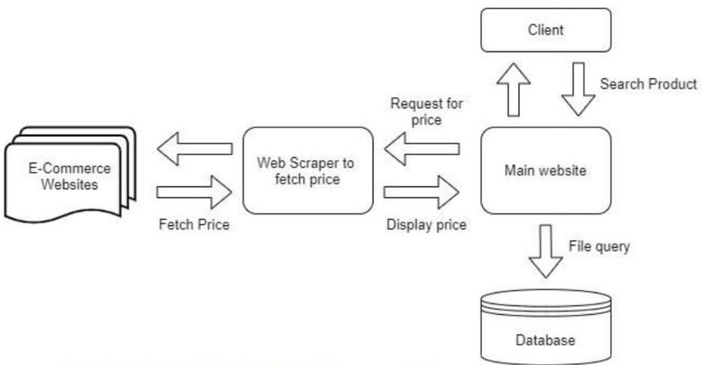
5.SYSTEM DESIGN
5.1 Architecture
Fig:System Architecture

Slide 21
5.2 System Modules
System Modules for a Price Comparison WebsiteUser Management – User registration, login, profile management, wishlist .Product Search & Filtering – Keyword search, sorting options.Price Comparison – Collects, matches, and ranks prices from multiple vendors.Product Details – Displays product specs, images, reviews, and vendor links.Data Collection & Integration – Uses web scraping/APIs to fetch updated prices..

Slide 22
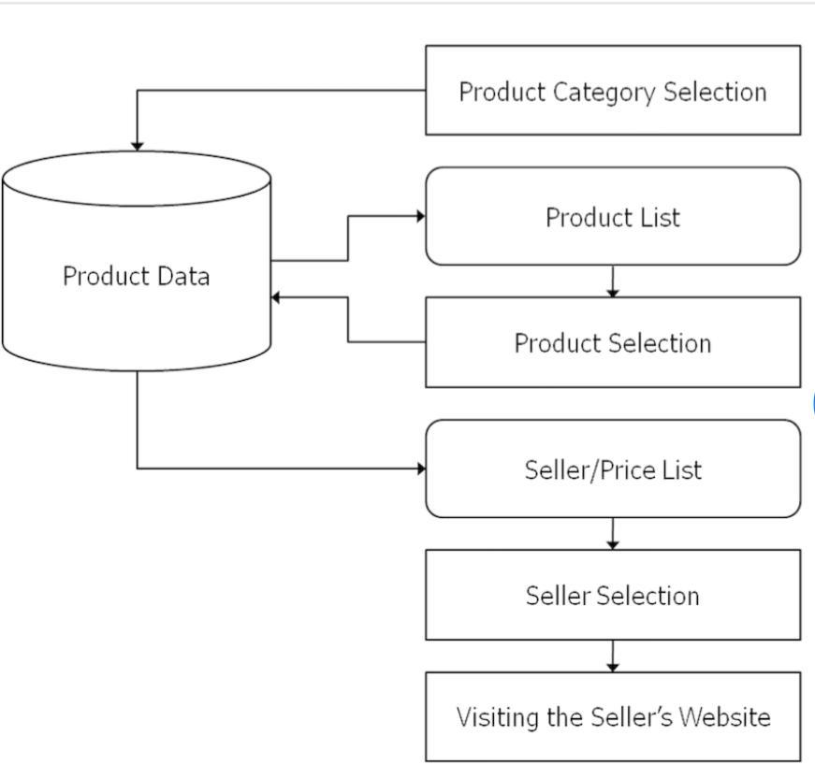
A data flow diagram shows the way information flows through a process or system. It includes data inputs and outputs, data stores, and the various sub processes the data moves through.
5.3 Data Flow Diagram
Fig: Data Flow Diagram

Slide 23
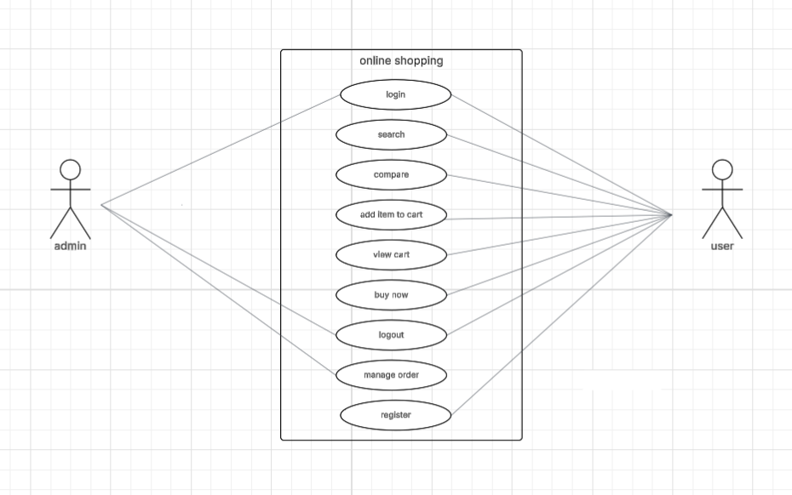
Use case Diagram A Use Case Diagram in Unified Modeling Language (UML) is a visual representation that illustrates the interactions between users (actors) and a system.
5.4 UML Diagrams
Fig: Use case Diagram

Slide 24
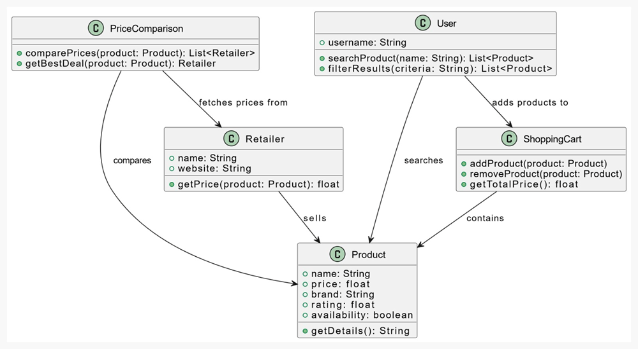
Class Diagram A UML class diagram is a visual tool that represents the structure of a system by showing its classes, attributes, methods, and the relationships between them.
Fig:Class Diagram

Slide 25
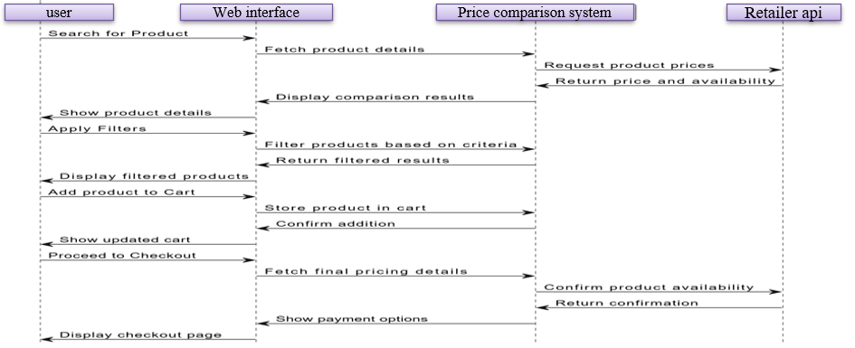
A sequence diagram in Unified Modeling Language (UML) is a diagram that shows how objects interact over time. It’s a type of interaction diagram that illustrates the order and timing of messages between objects in a system.
Sequence Diagram
Fig:Sequence Diagram

Slide 26
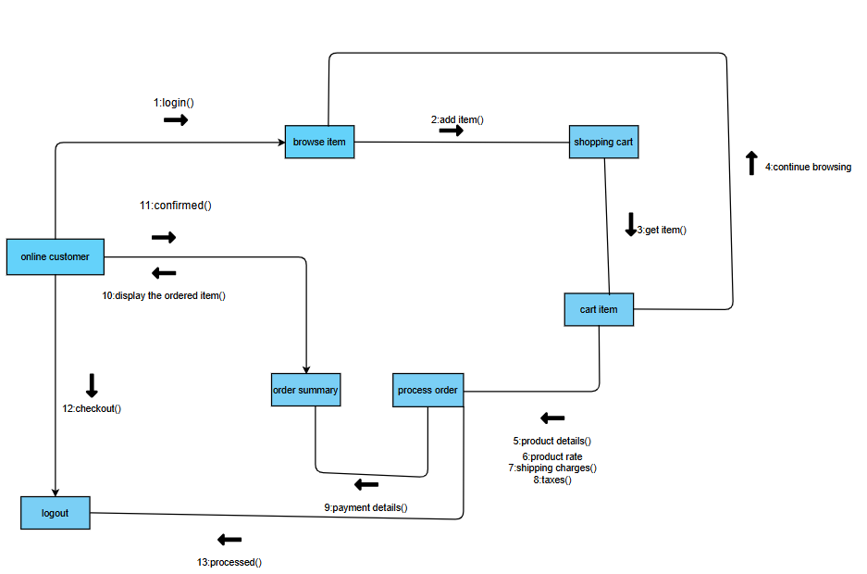
Collaboration Diagram In UML diagrams, a collaboration is a type of structured classifier in which roles and attributes co-operate to define the internal structure of a classifier
Fig:Collaboration Diagram

Slide 27
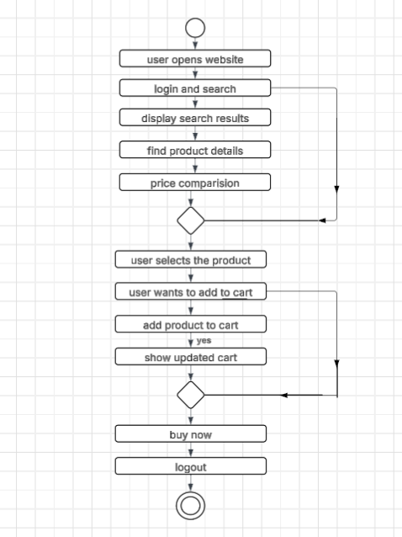
An activity diagram in Unified Modeling Language (UML) is a flowchart that shows how activities flow through a system or process. It's a type of behavior diagram that models how a system should behave.
Activity Diagram
Fig: Activity Diagram

Slide 28
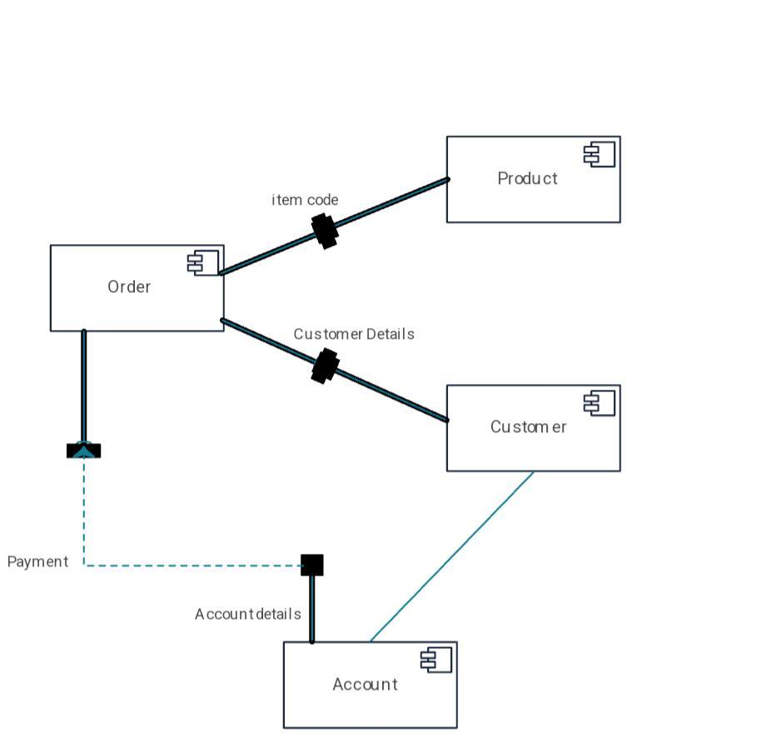
Component Diagram Component diagrams show the structure of the software system, which describes the software components, their interfaces, and their dependencies
Fig:Component Daigram

Slide 29
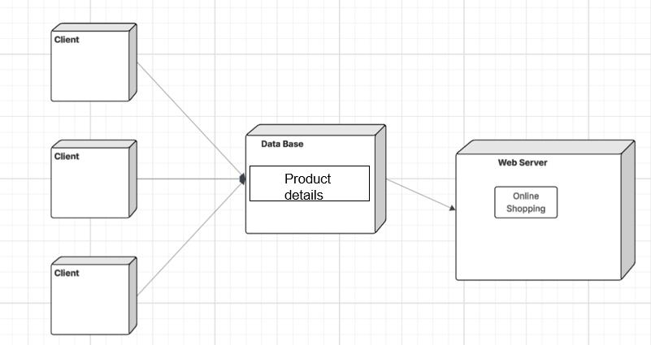
Deployment Diagram A deployment diagram shows components and artifacts in relation to where they are used in the deployed system.
Fig:Deployment Diagram

Slide 30
6.IMPLEMENTATION
6.1 Algorithms Used
1.Search Algorithm (Basic String Matching). To filter and display products based on the search query.. 2.Dynamic DOM (Document Object Model) Manipulation: Display products dynamically after search. 3.Data Normalization The database schema is normalized to prevent data redundancy. Products are stored with consistent attributes (store, description, price, link, etc.).

Slide 31
4.Carousel Algorithm Creates a carousel or slider to display images or content in a rotating manner. Use HTML structure for slides (e.g., <div> elements) containing images or content. CSS for styling the slides and defining their positions. JavaScript for implementing the carousel functionality. 5.Web Scrapping algorithms Parsing Algorithms(Beautiful Soup) These tools extract product details, prices, and stock availability from multiple e-commerce websites

Slide 32
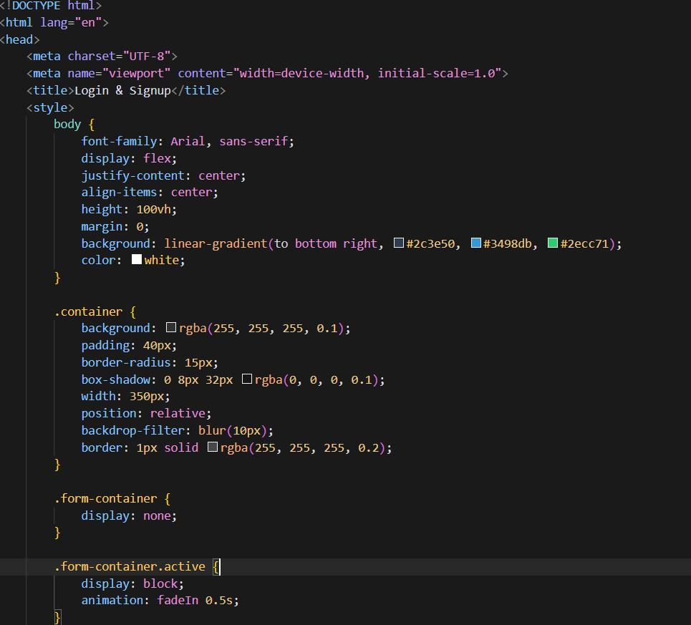
6.2 Sample Code
Login page

Slide 33
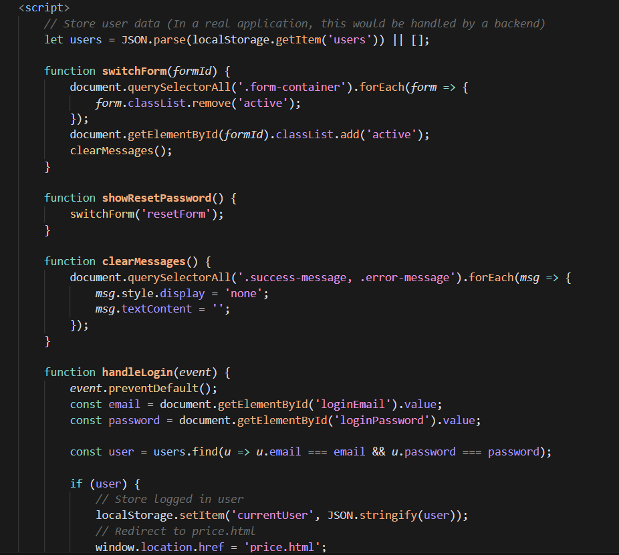

Slide 34
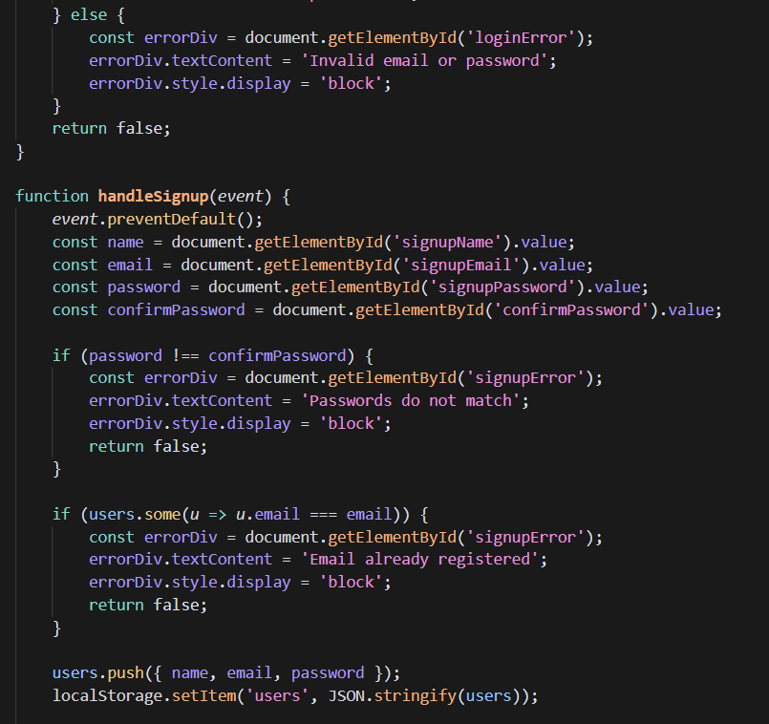

Slide 35
7.SYSTEM TESTING
7.1 Test Cases
Test Case | Module | Scenario | Expected Result | Status
TC01 | Login Page | Valid login credentials | Redirect to user dashboard | Pass
TC02 | Login Page | Invalid login credentials | Show "Invalid credentials" error | Pass
TC03 | Login Page | Empty email or password | Show "Field required" message | Pass
TC04 | Main Website | Search for a valid product | Display matching products | Pass
TC05 | Main Website | Compare product prices | Show vendor price list | Pass
TC06 | Main Website | Add to Wishlist without login | Ask user to log in | Pass
TC07 | Admin Page | View list of registered user | Show user table with details | Pass

Slide 36
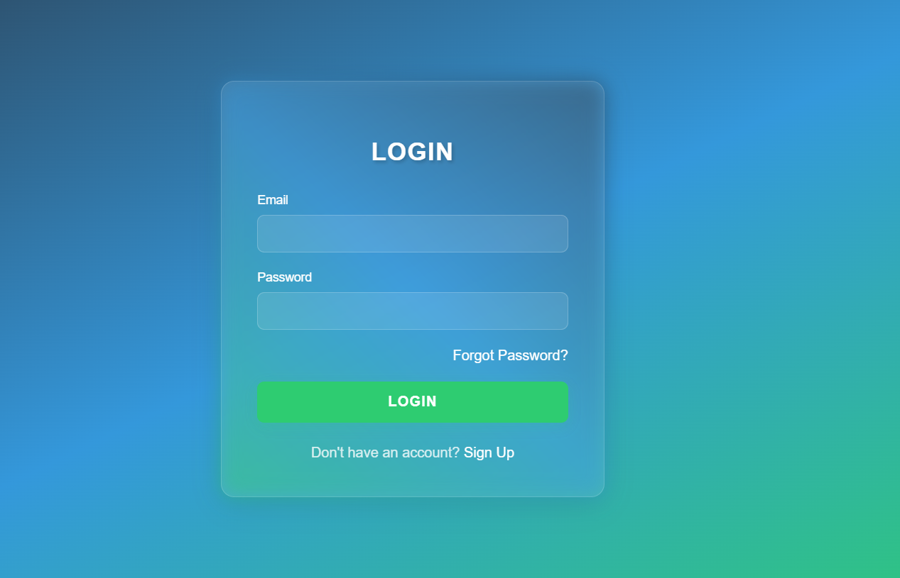
7.2 Results and Discussion
Login Page: The login page is a entry point for user to access a website or application, requiring them to authenticate with their credentials
Fig: Login Page

Slide 37
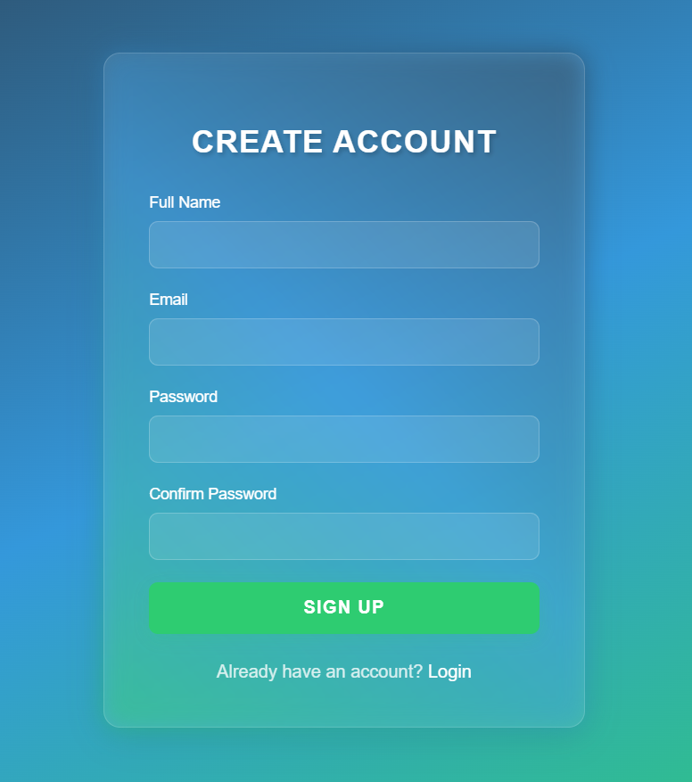
Signup Page:A sign-up page is a place where you fill in your details to make a new account on a website or app.
Fig: Sign up Page

Slide 38
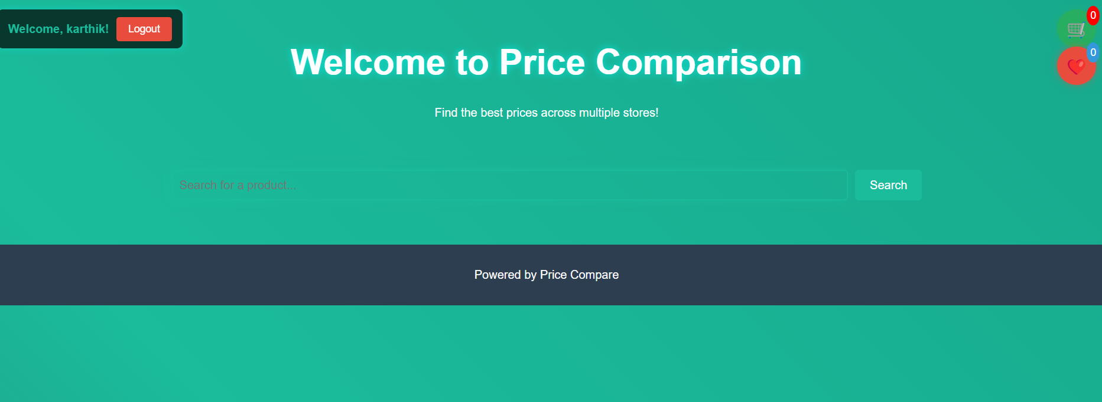
Home Page: A home page is the first page you see when you open a website. It's like the front door that shows you what the site is about and where you can go next
Fig:Home Page

Slide 39
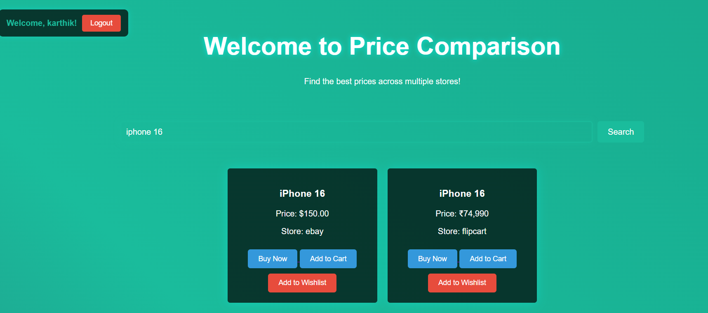
Product search: when you search for a product it shows the best two websites and prices are displayed
Fig: product details and prices details

Slide 40
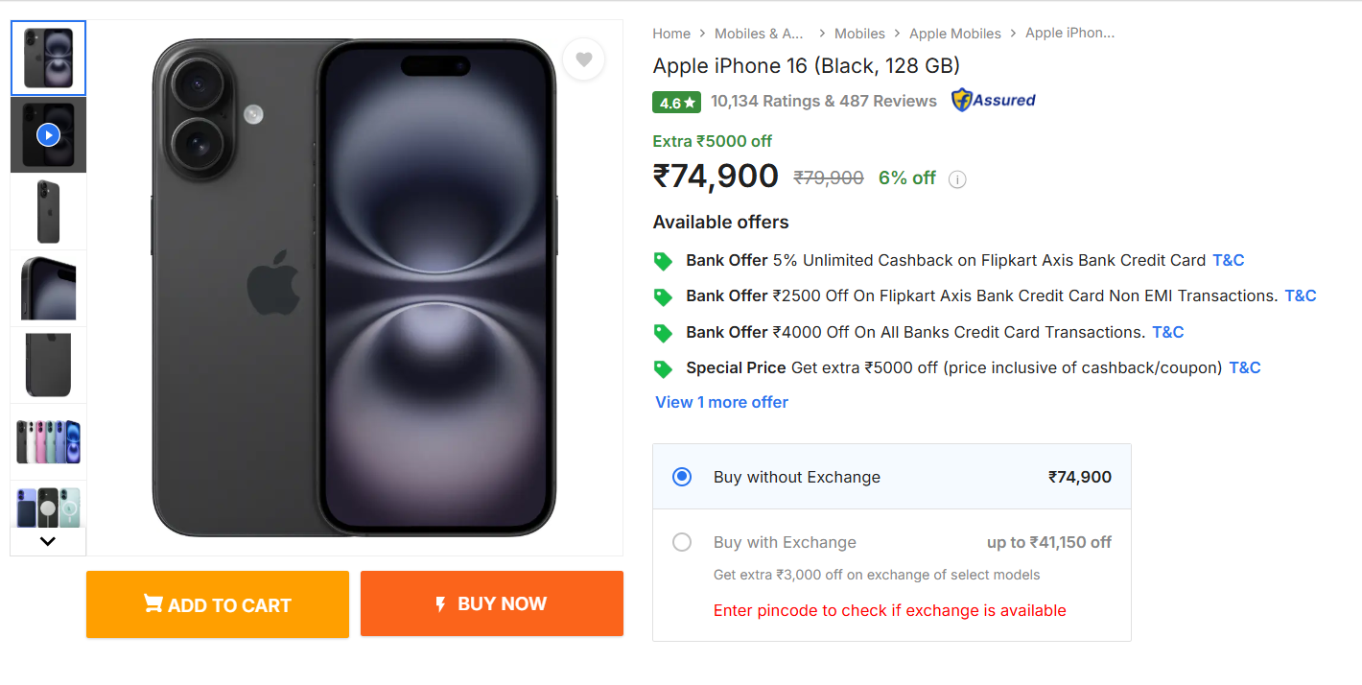
Product(iPhone 16): when you click on buy now the page will be directed to that particular website
Fig: iPhone 16(product)

Slide 41
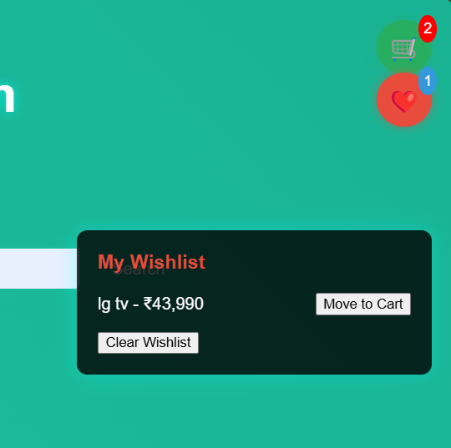
Wishlist: where it allows users to create personalized collections of product they want to buy and save them for future reference
Fig: Wishlist

Slide 42
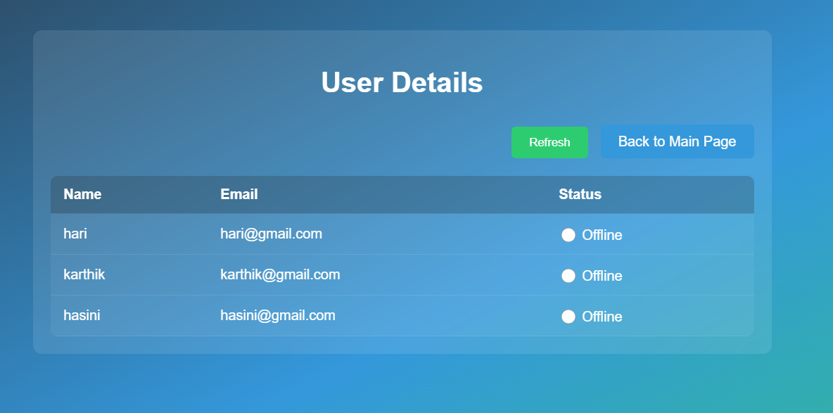
Admin Page: It stores the users logins and also check status of the user
Fig:Admin Page

Slide 43
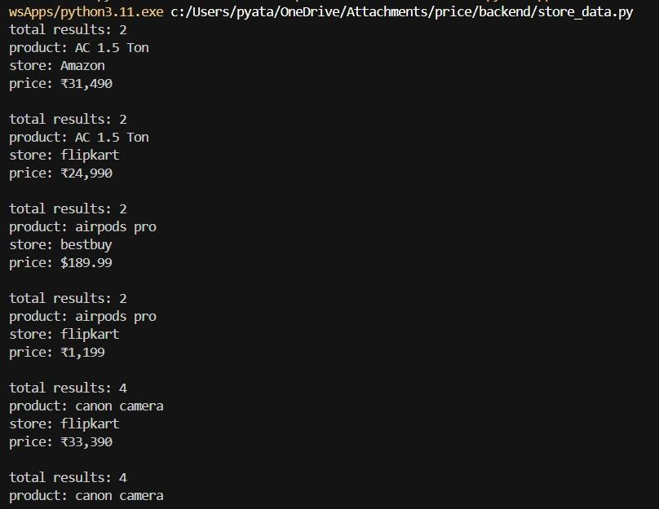
Store data :It is a Python script that creates and manages a SQLite database for storing product information from multiple e-commerce platforms, enabling price comparison across different stores while preventing duplicate entries.

Slide 44
8.CONCLUSION AND FUTURE SCOPE
8.1 Conclusion
The Price Comparison Website for Online Shopping project aimed to provide users with an intuitive and efficient platform for comparing prices across various online retailers. By aggregating product data from different sources, the website allows customers to make informed purchasing decisions, saving both time and money.

Slide 45
8.2 Future Scope
Smart Help with AI: These websites will learn what you like by looking at what you search for and buy. Then, they’ll show you the best products—not just the cheapest, but the ones with the best value for you.
Search by Voice or Photo: Instead of typing, you’ll be able to just talk or take a picture to find what you’re looking for.
Live Price Updates: Prices online change all the time. Future websites will track prices in real-time and let you know when something gets cheaper.
Safer Shopping: New tech like blockchain will make your online shopping more secure and trustworthy.
More Business Growth: These websites will make money through affiliate links (getting a small fee when you buy through them) but will stay free for users.

Slide 46
9.REFERENCES
1.The use of web scraping in computer parts and assembly price comparison
LR Julian, F Natalia - 2015 3rd International Conference on …, 2017 - ieeexplore.ieee.or
2. An overview on web scraping techniques and tools. AV Saurkar, KG Pathare, SA Gode -
International Journal on Future …, 2018 - ijfrcsce.org
3. Web scraping for unstructured data over web. GN Chandrika, S Ramasubbareddy,
K Govinda… - Embedded Systems and …, 2020 - Springer
4. Web content extraction using contextual rules, Ahmad Pouramini, Shahram Nasiri
International Conference on Knowledge-based Modeling and Innovation. IEEE, 2019

Slide 47
THANK YOU

